Slide 1
CGC-SCIPE Workshop Day 2
Dr. Xiaoxu Guo
xguo@umces.edu
Aug 28, 2025

Slide 2
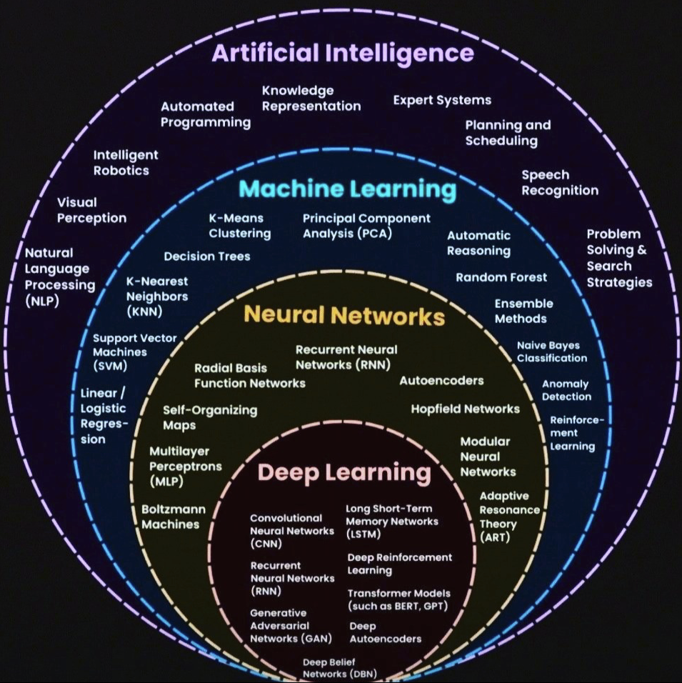
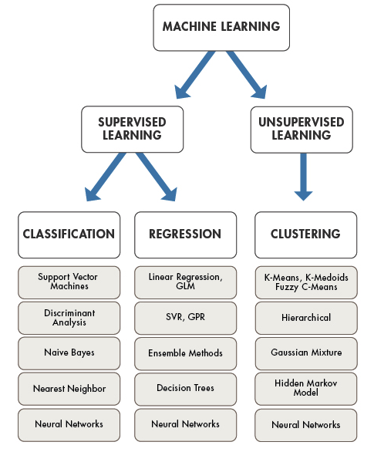
Reference: Nebula Cloud
Reference: MATLAB MathWorks

Slide 3
Tutorial 1. Predict Dissolved Oxygen at Depth in Chesapeake Bay from Surface Measurements

Slide 4
Tutorial 1. Predict Dissolved Oxygen at Depth in Chesapeake Bay from Surface Measurements
Dissolved oxygen (DO) is the amount of oxygen gas that is present in the water.
Why is dissolved oxygen important?
Like humans, all of the Chesapeake Bay’s animals—from the fish and crabs that swim through its waters to the worms that bury themselves in its muddy bottom—need oxygen to survive.
How does oxygen get into the water?
1. Oxygen from the atmosphere dissolves at the water’s surface (more in cold water than warm).
2. Algae and underwater plants release oxygen during photosynthesis.
How do low-oxygen areas form?
Respiration or conversion of organic carbon to CO₂, requires oxygen. In Chesapeake Bay, phytoplankton that bloom in spring due to nutrients from rivers, eventually sink to the bottom. Bacteria are fueled by this “food”, respiring the organic material and using up oxygen. Warmer temperatures at the Bay surface seal off this low oxygen zone from the atmosphere. This creates hypoxic, or low-oxygen, regions with less than 2 mg/L of dissolved oxygen. These areas are often called “dead zones” because most animals cannot survive there. Areas in the Bay that have low dissolved oxygen levels are the result of an interaction of natural and man-made factors, including temperature, nutrient pollution, water flows, and the shape of the Bay's bottom.
Thus, surface quantities like temperature or chlorophyll might be related to the size and intensity of the “Dead Zone” below.
Reference: https://www.chesapeakebay.net/discover/ecosystem/dissolved-oxygen#:~:text=Why%20is%20dissolved%20oxygen%20important,bottom—need%20oxygen%20to%20survive.

Slide 5
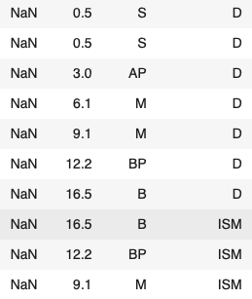

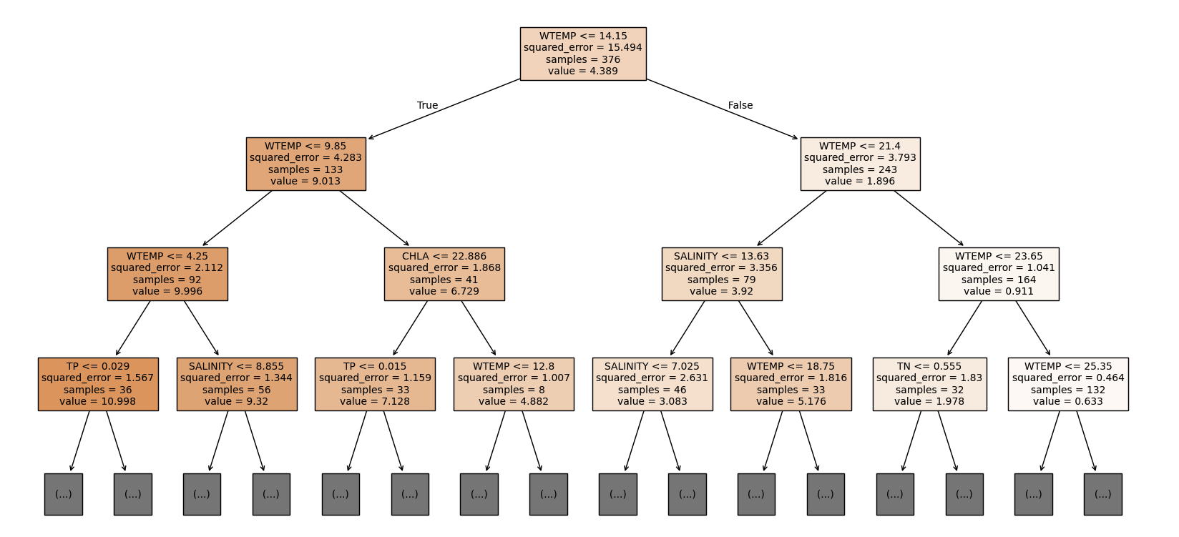
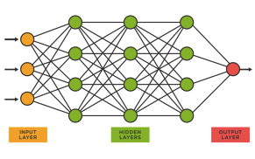
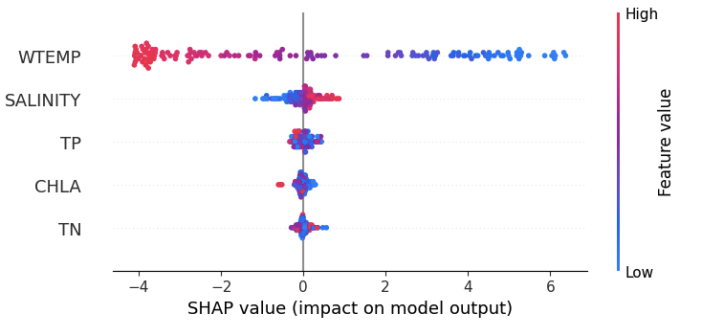
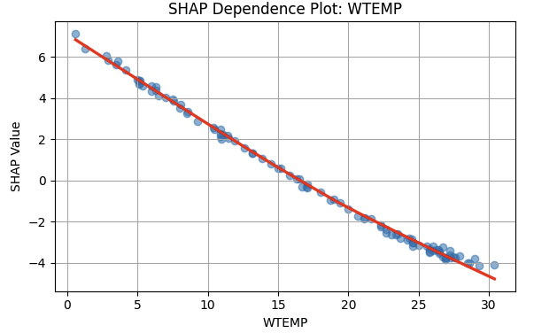
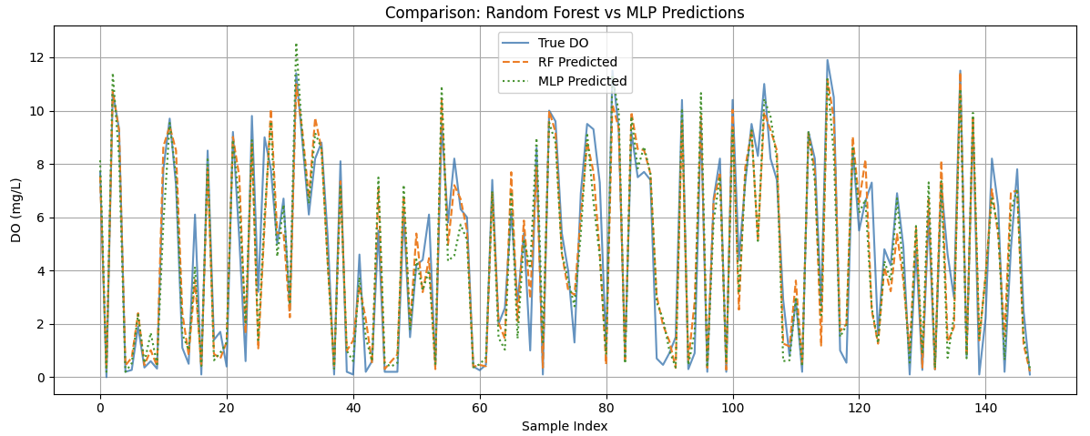
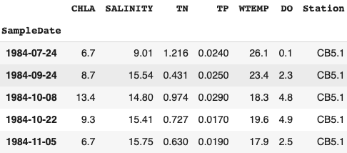
Tutorial 1. Predict Bottom DO from Surface Measurements
Measurement
Variables,
Date Range, …
Data Retrieval
Total number of rows: 61053, columns 29,
Number of days 813 …
Data Cleaning
Rows: 736, Columns 8
Data Reconstruction
Modeling/
Validation
Discussion

Slide 6
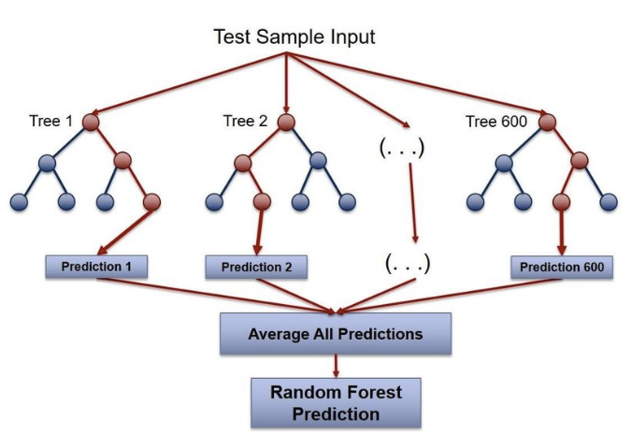
Tutorial 1. Predict Bottom DO from Surface Measurements
What is Random Forest Regression (Machine Learning)?
Random Forest Regression is an ensemble learning method that builds multiple decision trees and averages their predictions for numerical (continuous) outputs.
It belongs to bagging methods (Bootstrap Aggregation).
Each tree sees only a random subset of the data and a random subset of the features.
Predictions from all trees are averaged (regression) or voted (classification).
Let’s break it down step by step:
Input: A dataset of features X (e.g. surface measurements) and a continuous target y (e.g. dissolved oxygen). Split into training and testing datasets.
Bootstrap Sampling:
Create multiple subsets of the training data with replacement.
Each subset is used to train one decision tree.
Feature Randomness:
At each split in a tree, only a random subset of features is considered.
Tree Construction:
1. At every node in the tree: For each candidate split, calculate the Mean Squared Error (MSE) 2. Choose the feature and threshold that result in the lowest MSE. 3. Split the node and repeat the process recursively.
This is what builds the structure of each decision tree based on minimizing prediction error. It learns a different view of the data due to randomness in data and features.
5. Prediction:
For a new sample, each tree makes a prediction.
The final prediction is the average of all tree predictions.

Slide 7
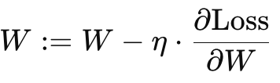
Tutorial 1. Predict Bottom DO from Surface Variables
What is Multilayer Perceptron (MLP) ?
Multilayer Perceptron (MLP) is a type of neural network used for tasks like regression or classification. It’s made up of layers of connected neurons:
Input layer: where the data comes in
Hidden layer(s): where most of the computation happens
Output layer: where the prediction comes out
Each neuron takes some inputs, does a weighted sum, applies an activation function, and passes the result forward.
1: Initialize Randomly initialize weights and biases for each layer.
2. Forward Pass
For each training sample:
Pass input through the input layer.
For each layer:
z = W·x + b (weighted sum)
a = activation(z)
Continue until you get the final output prediction ŷ.
3. Compute Loss
Compare the prediction ŷ to the true value y using a loss function (e.g., MSE for regression):
4: Backward Pass (Backpropagation)
Compute gradients of the loss with respect to all weights and biases.
Use the chain rule to go layer by layer backward, adjusting the parameters.
5. Update Weights
Use an optimizer (gradient descent, Adam...) to update weights: , where η is the learning rate.
6. Repeat Loop over all training data for multiple epochs until loss is minimized.

Slide 8
Tutorial 1. Predict Bottom DO from Surface Variables
SHAP (SHapley Additive exPlanations) explains how much each predictor contributed to a model’s prediction, for each individual prediction.
Imagine a team of features playing a game to predict bottom oxygen. The final prediction is the “score” the team achieves. SHAP asks: "If we remove one player (surface measurement type), how much does the team’s score change?"
By testing all combinations of feature contributions, SHAP computes each feature’s average contribution — this is the SHAP value.

Slide 9
Playground time, let’s go have some fun!
Cleaning up the data is the most time consuming process… But, today you don’t need to clean up the data by yourself, we will start with the cleaned up data : )

Slide 10
Hackathon Track A. Predict Future Dissolved Oxygen in Chesapeake Bay
Hackathon Track B. Predict Phytoplankton (Chlorophyll-a) from Satellite Remote Sensing of Ocean Color (Sentinel-3 OLCI) over Chesapeake Bay

Slide 11
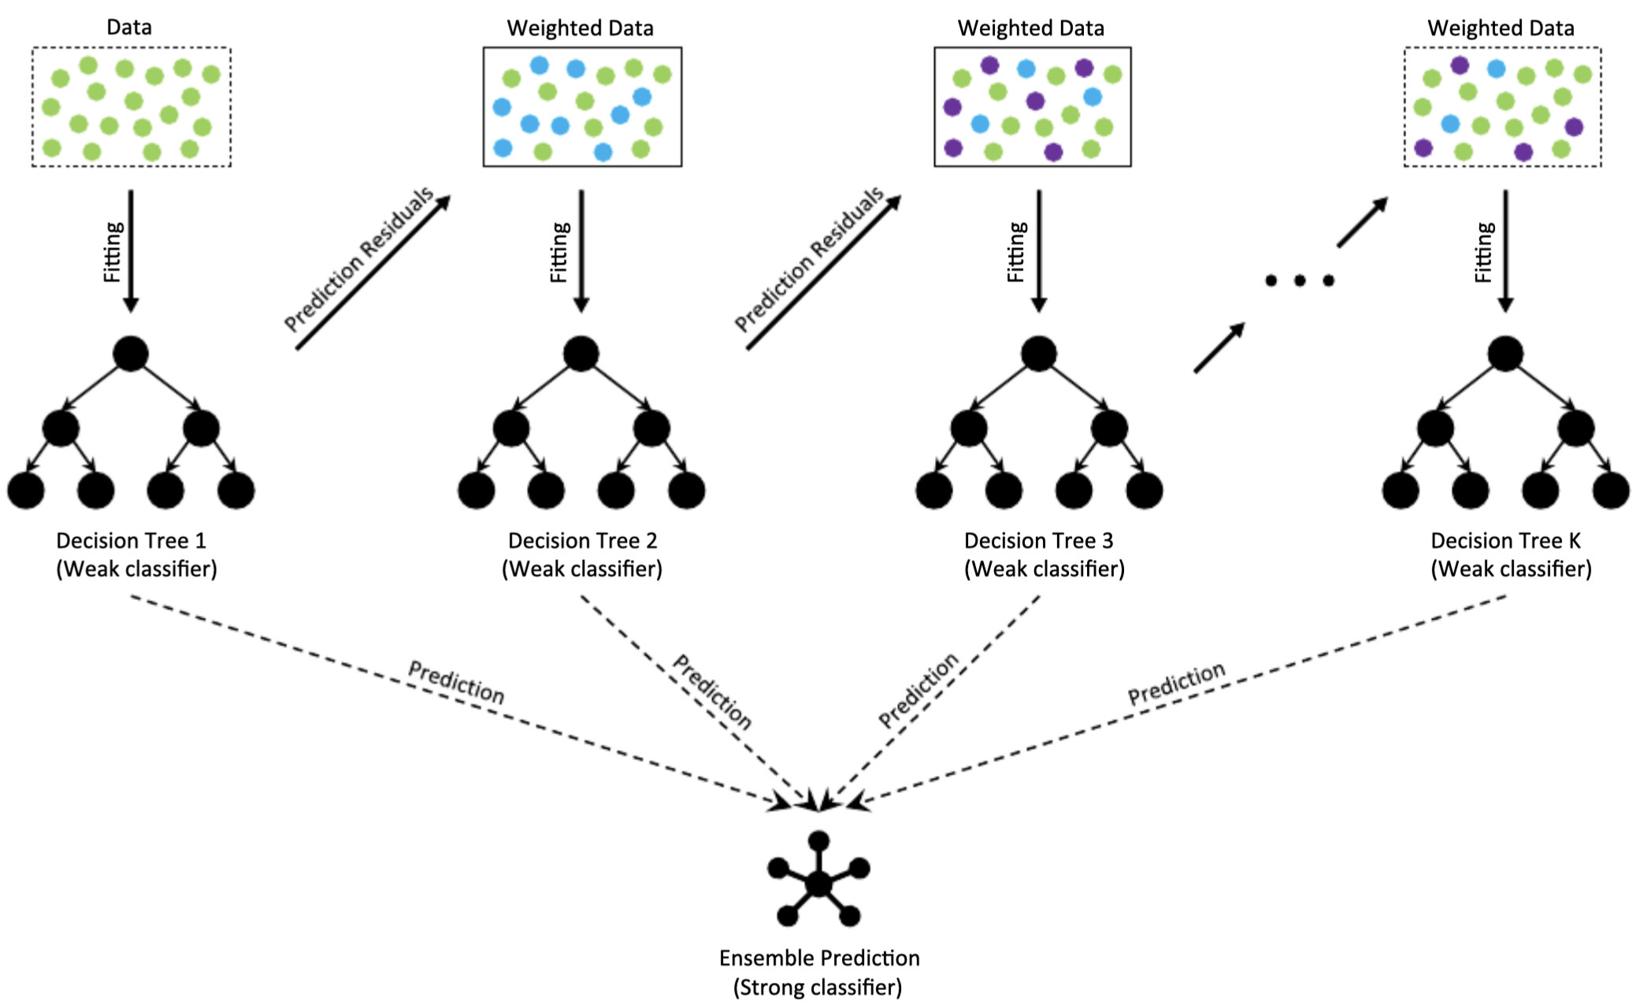

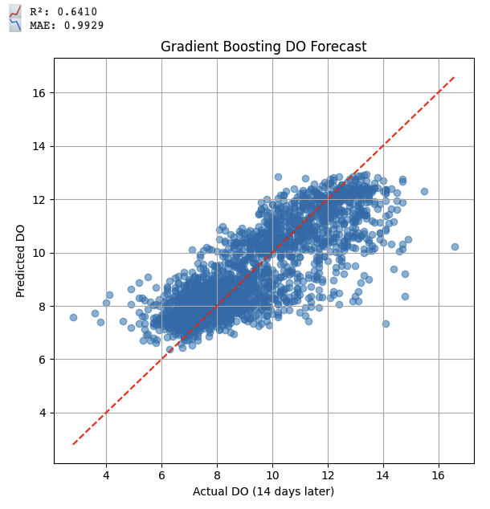
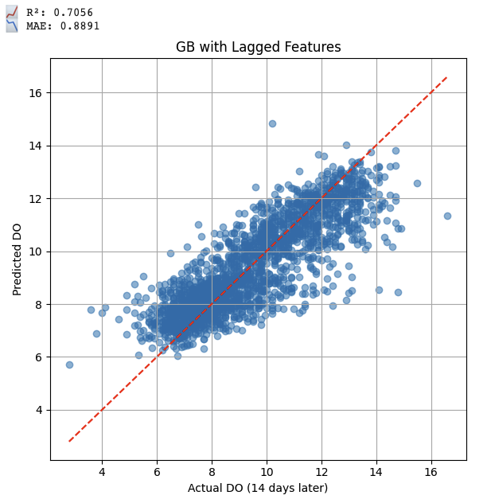
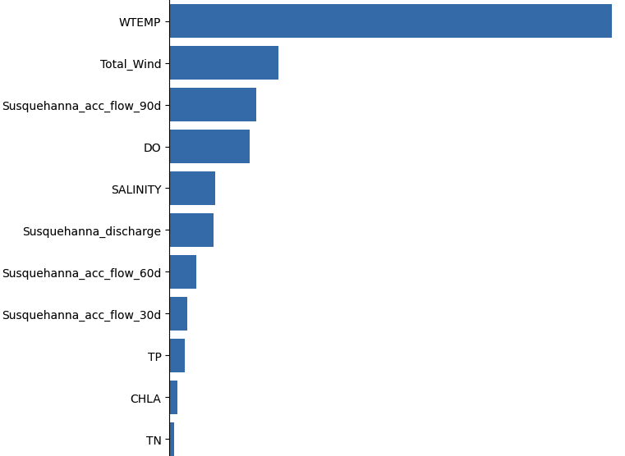
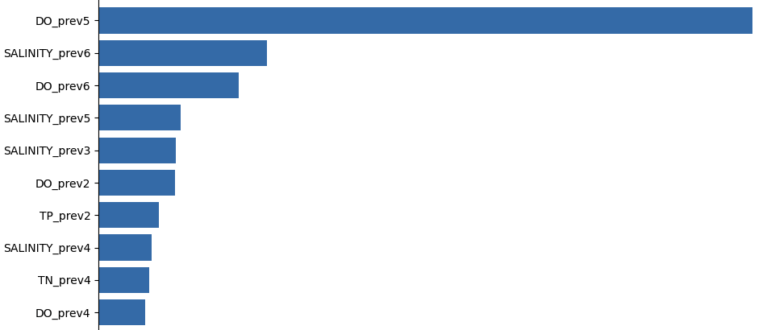
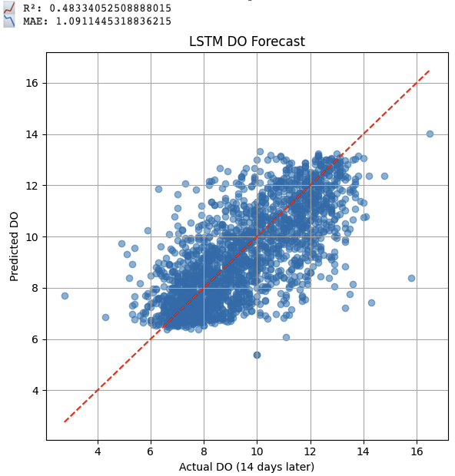
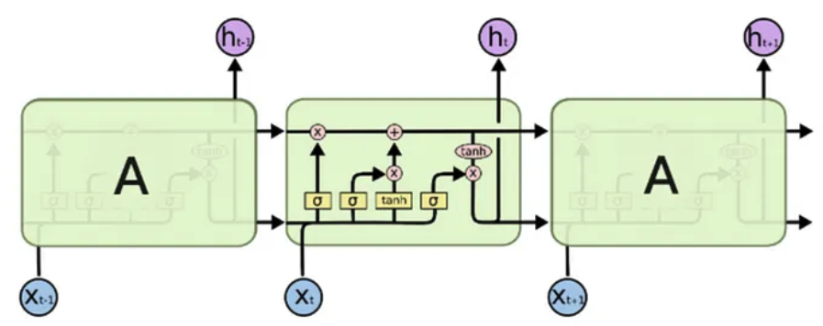
Advanced Tutorial 2. Predict Future DO
Measurement
Water Quality Data:
Data Retrieval
Discharge:
Wind Feature:
Data Cleaning
Feature
Engineering
Data Reconstruction
Time Series
For Gradient Boosting: Add Lagged features, like accumulated discharge
Modeling/
Validation
Or LSTM: naturally captures the temporal relationships
Discussion

Slide 12
Advanced Tutorial 2. Predict Future DO
What is Gradient Boosting Regression?
Gradient Boosting is an ensemble learning method that builds a strong regressor by combining many weak learners (typically decision trees).
The key idea: Each new tree corrects the errors made by the previous trees.
Bagging (e.g., Random Forest): Train multiple models in parallel on different random subsets of data
Boosting (e.g., Gradient Boosting): Train models sequentially, where each new model fixes the errors of the previous one
Start with a simple model
Compute residuals
Train a decision tree on these residuals
Update the model
Repeat steps 2–4
Final prediction: accumulation of all previous trees (total of all corrections)

Slide 13
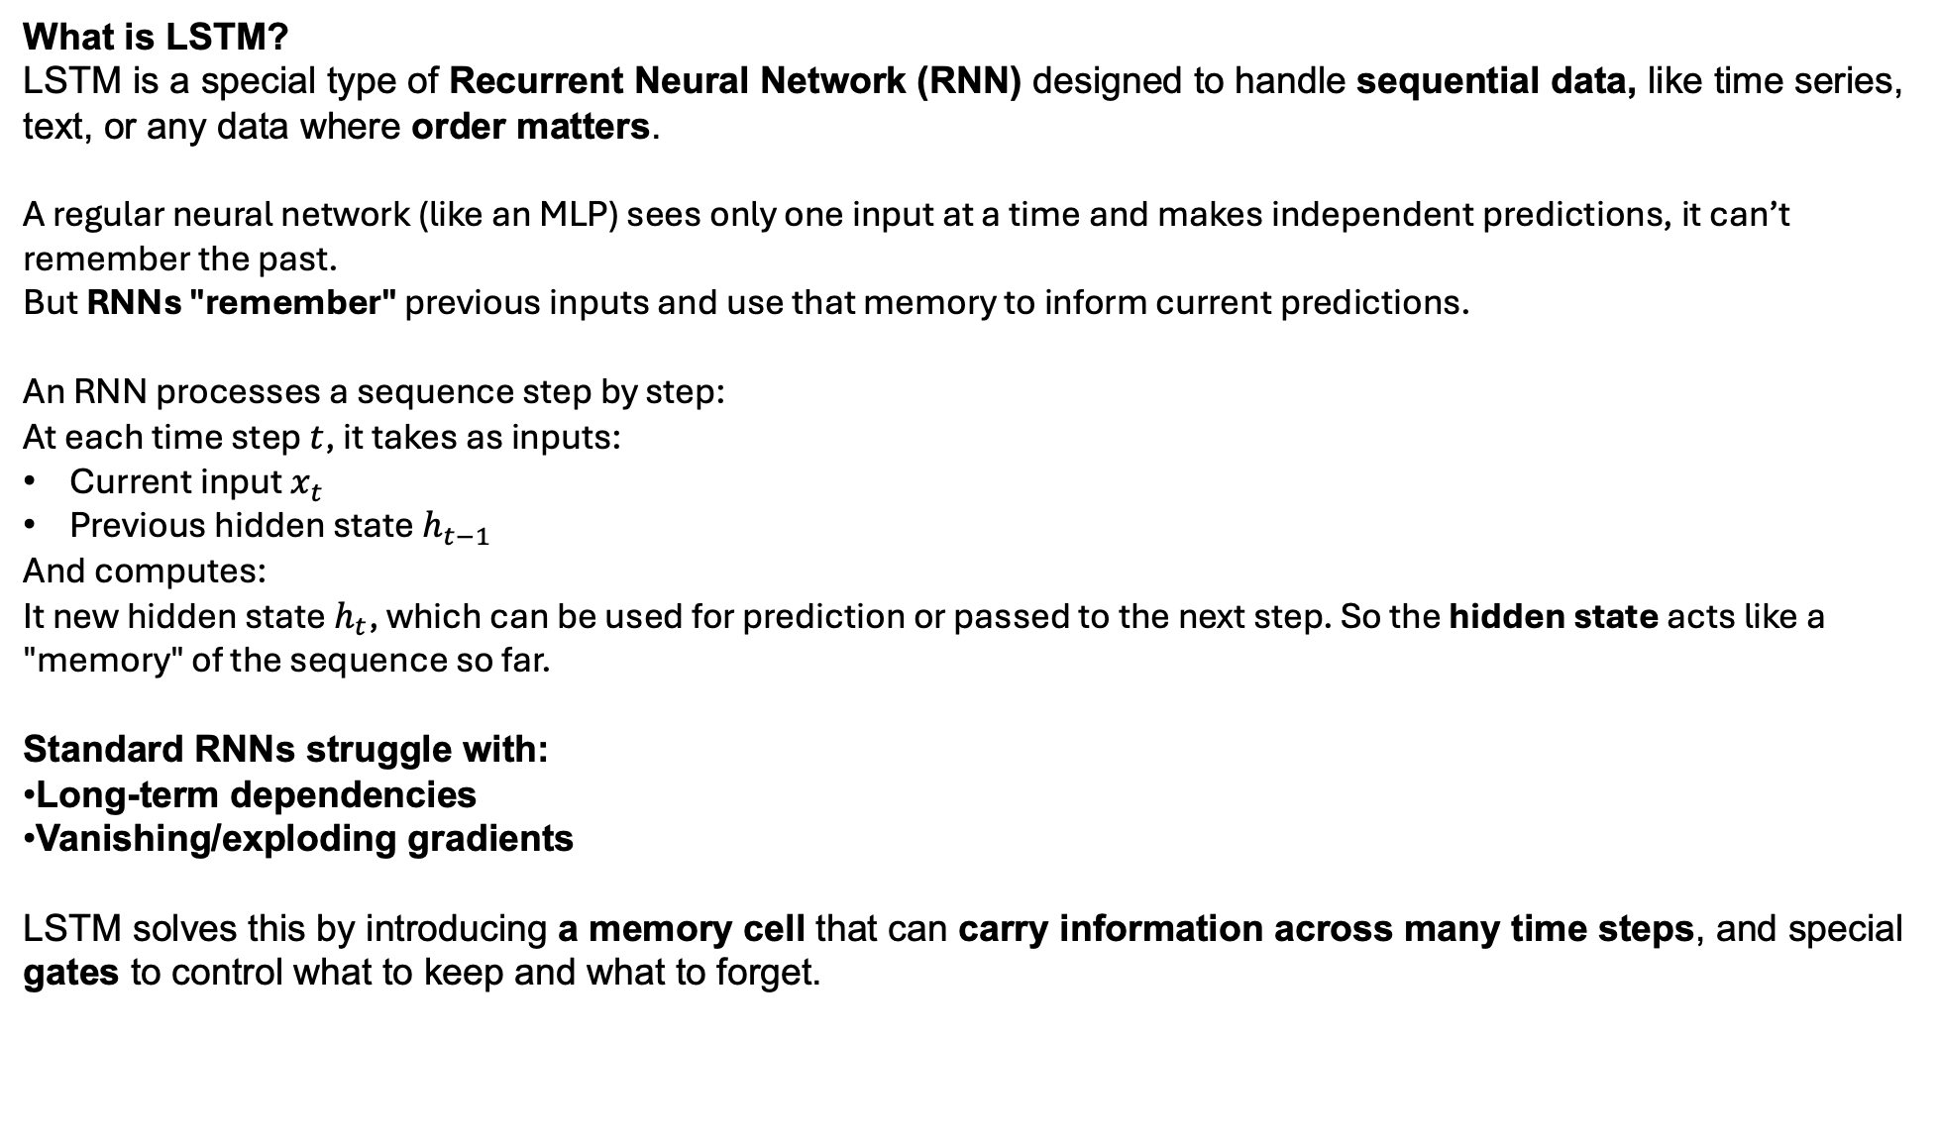
Advanced Tutorial 2. Predict Future DO
What is LSTM?
LSTM is a special type of Recurrent Neural Network (RNN) designed to handle sequential data, like time series, text, or any data where order matters.
A regular neural network (like an MLP) sees only one input at a time and makes independent predictions, it can’t remember the past.
But RNNs "remember" previous inputs and use that memory to inform current predictions.
An RNN processes a sequence step by step:
At each time step $t$, it takes as inputs:
Current input $x_{t}$
Previous hidden state$h_{t−1}$
And computes:
It new hidden state $h_{t}$, which can be used for prediction or passed to the next step. So the hidden state acts like a "memory" of the sequence so far.
Standard RNNs struggle with:
Long-term dependencies
Vanishing/exploding gradients
LSTM solves this by introducing a memory cell that can carry information across many time steps, and special gates to control what to keep and what to forget.

Slide 14
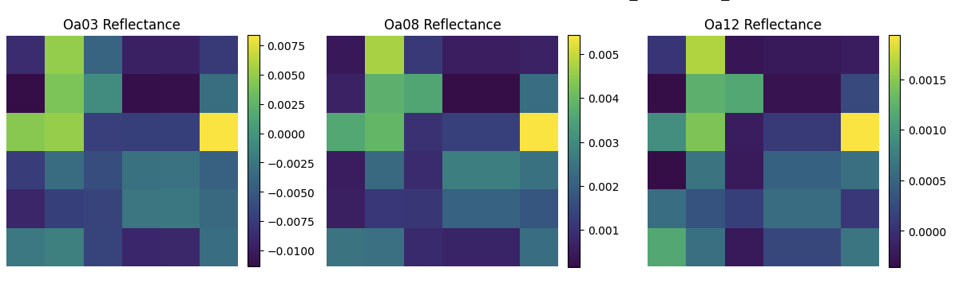

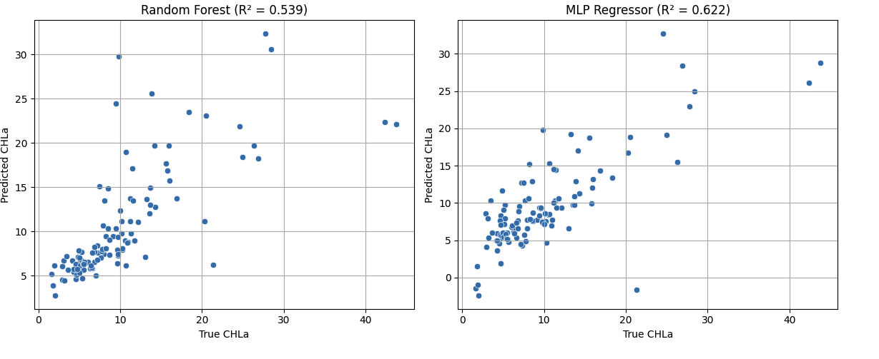
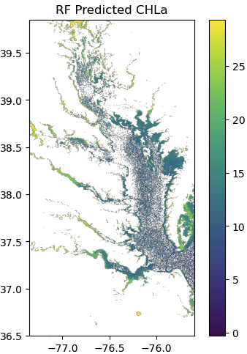
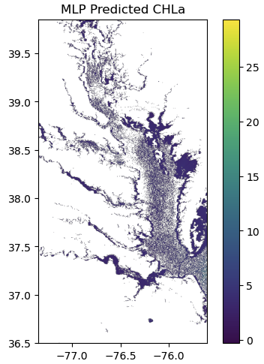
Advanced Tutorial 3. Predict Chlorophyll-a from Sentinel-3 OLCI at Chesapeake Bay
Measurement
Water Quality Data:
Data Retrieval
Sentinel-3 OLCI Data:
Data Cleaning
Feature
Engineering
Data Reconstruction
With Atmosphere Correction or not?
Include Band Ratios?
Modeling/
Validation
Mask Ratio Threshold?
Patch Radius?
Date exactly match ?
Discussion

